Slide 1


Teaching Visualization Literacy
go.ncsu.edu/vizcrashcourse1
Alison Blaine ablaine@ncsu.edu
Jennifer Garrett jigarret@ncsu.edu
Hannah Rainey hlrainey@ncsu.edu
Notes:
Jennifer

Slide 2
Overview
go.ncsu.edu/vizcrashcourse1
Visualization Literacy Discussion
Fundamental Visualization Concepts
Data Visualization Theory and Process
Activity
Discussion
Notes:
Jennifer

Slide 3

Table Discussion
Introduce yourself -
name, dept., focus/research area
Do you incorporate data visualization in your job duties, teaching, and/or assignments?
What does visualization literacy mean to you?
Take notes on the table
Notes:
Jennifer

Slide 4
Group Discussion
What keywords or key concepts describe visualization literacy?
Notes:
Jennifer

Slide 5
Data Visualization
Why Visualize?
Notes:
Hannah - let’s shift our discussion a moment now to talk about why we visualize and why data visualization literacy is important.

Slide 6
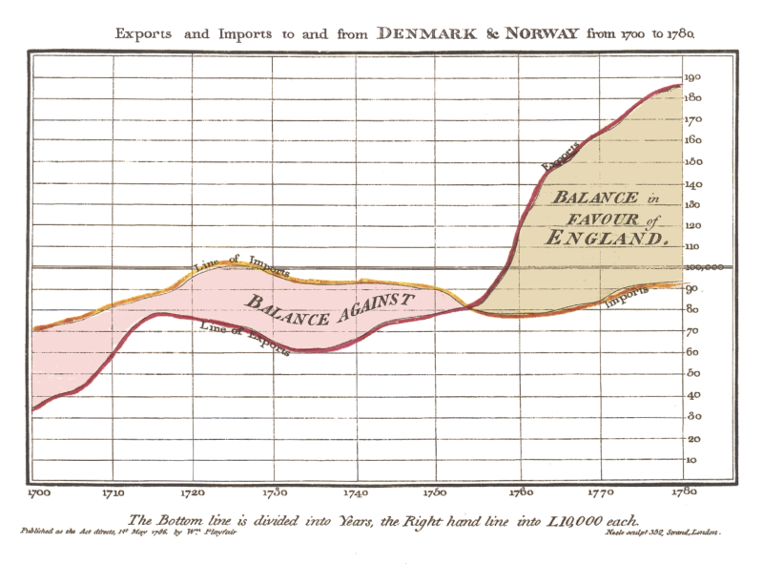
Data Visualization is an old endeavor
Notes:
Hannah - Data visualization pre-dates the era of big data, high processing computing, and design software. In fact, humans have always attempted to interpret and represent the world (data) around them. Statistical data visualization was grandfathered by William Playfair. He originated common chart types, such as line, bar, pie charts in the late 18th Century.

Slide 7
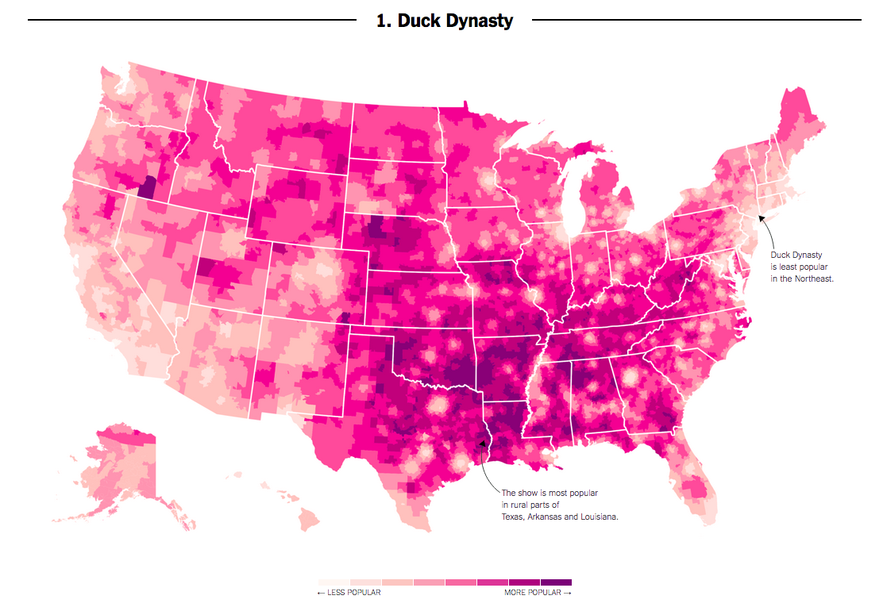
Data Visualization is Everywhere
Source
Notes:
Hannah - Visualizations of information are ubiquitous, especially online. The NYT Upshot is a great example of how data visualization is a key component in how we receive and interpret data.

Slide 8
Visual Literacy
Visual literacy skills equip a learner to understand and analyze the contextual, cultural, ethical, aesthetic, intellectual, and technical components involved in the production and use of visual materials. A visually literate individual is both a critical consumer of visual media and a competent contributor to a body of shared knowledge and culture.
-ACRL Visual Literacy Competency Standards for Higher Education
Notes:
Would anyone like to read this definition of visual literacy? Ask for a volunteer to read

Slide 9
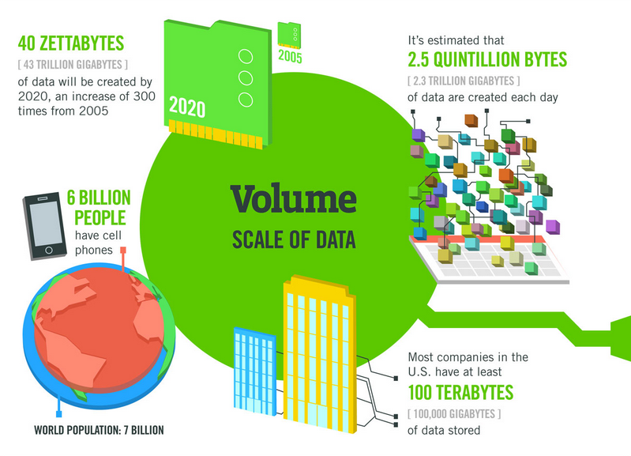
Source
Notes:
Jennifer
IBM originally published this visual. The main point here really is that data really is integrated into all aspects of our lives, whether we think about it or not. And the amount of data out there is incredibly large! large amounts of it are being created every day.

Slide 10
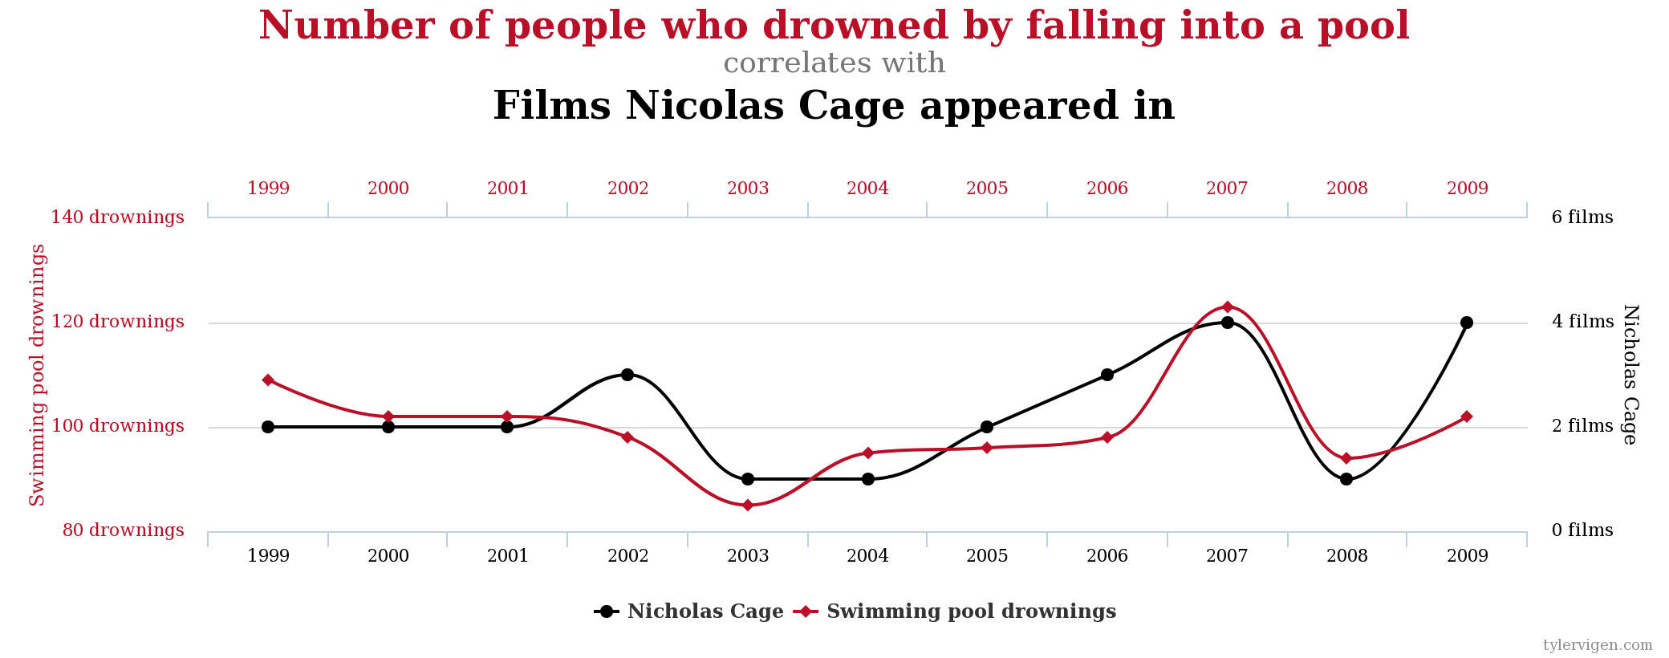
Data Integrity
Source
Notes:
Hannah - The increase in both visual content and available data makes misleading or outright wrong information harder to identify. Visualizations add credibility to any article. We are all at risk of believing misinformation without the critical awareness and skills. This example is from a website that illustrates how easy it can be to play with numbers and create stories that may not be true. This workshop focuses heavily on the design aspect of data visualization, but it is important to teach ourselves and our students about data integrity.

Slide 11
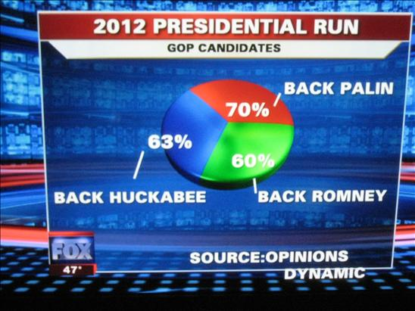
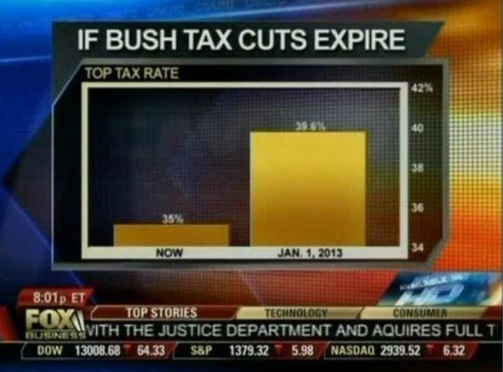
Integrity of Representation
Source
Notes:
Hannah - The previous example was funny, these examples can be damaging. In addition to data integrity, visualization literacy helps individuals assess the integrity of representations.

Slide 12
Data Visualization
Why it works?

Slide 13
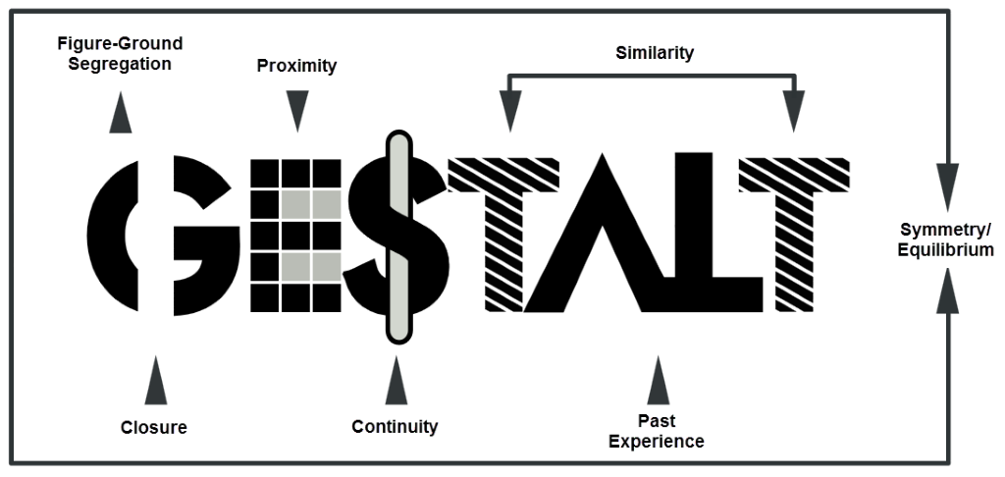
Source
Notes:
Hannah - “Gestalt theory was developed in the early twentieth century by German psychologists Max Wertheimer, Wolfgang Kohler, and Kurt Koffka. As opposed to the structuralist concept of breaking wholes into component parts, a Gestalt is a complete structure whose parts must be understood in relation to each other.” The basis of Gestalt psychology and theory is that the mind interprets chaos by grouping and relating information as parts of a whole. This graphic illustrates the principles of Gestalt theory as they relate to design. Beginning at the top-left, the “figure-ground segregation” separates the meaningful content from the background. “Proximity” illustrates that our brain identifies patterns of objects that are close together, the squares look like an E. “Similarity” allows for us to quickly identify two T’s. While Gestalt theories may have been challenged over the years, these principles are important for any visual design. These also aid in accessiblity.

Slide 14
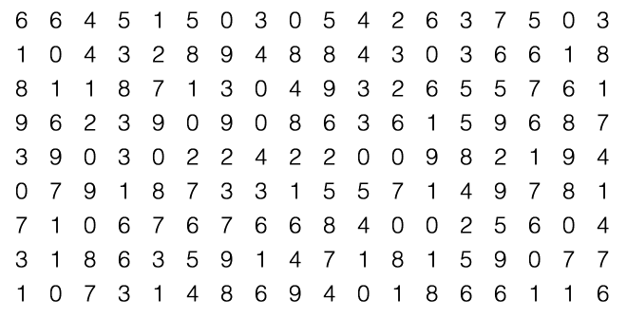
Pre-attentive Processing count the 9’s
Notes:
Hannah - Gestalt principles work well because our brains process information before we even know it, known as pre-attentive processing. To illustrate, count the 9’s...it takes a lot of cognitive work to go through each row and column

Slide 15
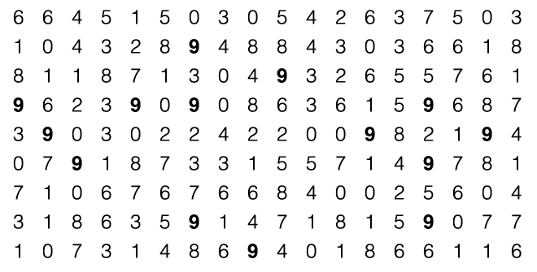
Pre-attentive Processing
Notes:
Hannah - now count the 9’s. Much easier right? Simply bolding the 9’s makes them easier to count. Our brains recognize the difference immediately.

Slide 16
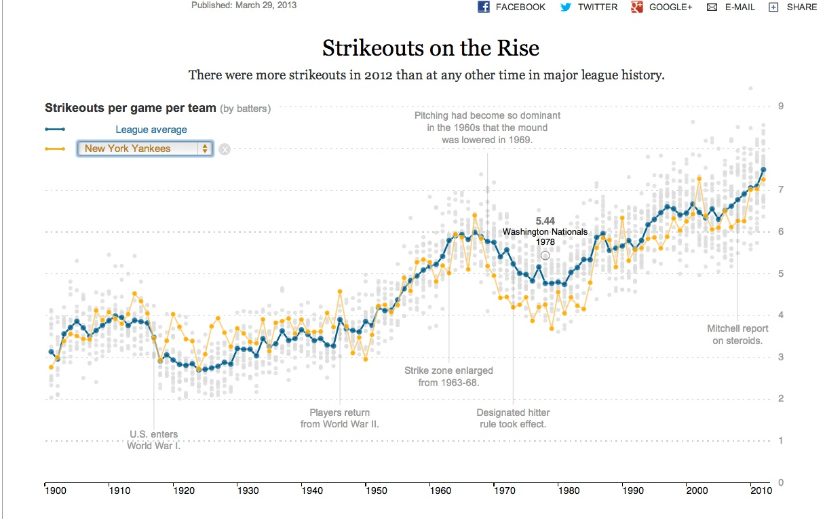
Meaningful title
Clear description
Context
Notes:
Jennifer - This is an example of a visualization that utilizes gestalt theory and pre-attentive processing to tell a story. But the visualization goes beyond the basics to really tell a story.
Meaningful content from the background - this is made all the more easier by the color choice of this design, right? We will talk about color considerations later.
Proximity - we also see that here in the two line charts, when they come together or deviate further.
And to add the story element and clarity of this design, they’ve added annotations and descriptions. All of this helps the reader have to work less hard to understand the goal of this visualization.

Slide 17
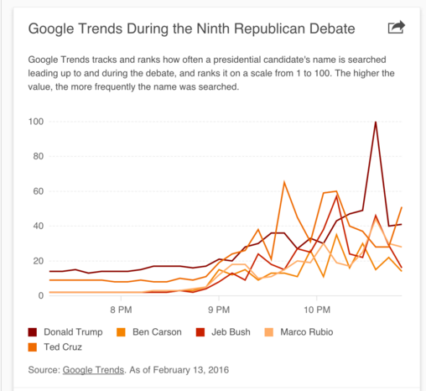
Notes:
Jennifer - This example visualization does a poor job...why?

Slide 18
Data Visualization
Design Principles
Notes:
Hannah - there are many considerations when creating a visualization. Utilizing basic design principles can turn a mediocre visualization into a great and compelling story.

Slide 19
Color
Type
S P A C E
Notes:
Hannah

Slide 20
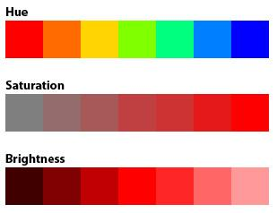
Color Tips
Categorical Data
Choose different hues. Consider grayer or more pastel shades over bold hues.
Ordinal Data
Keep same hue and vary chroma or brightness
Notes:
Hannah

Slide 21
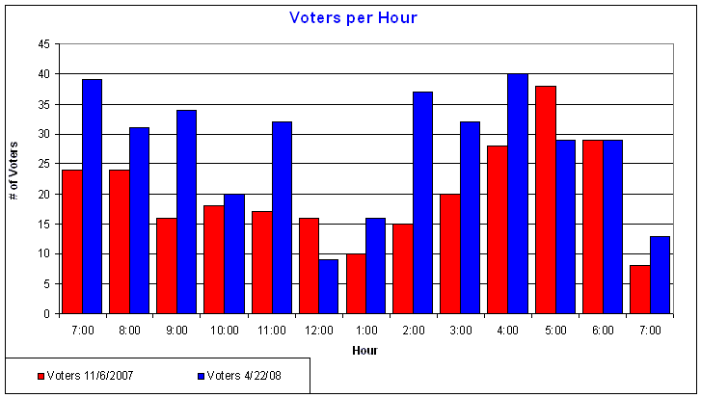
Cultural Significance
Source
Notes:
Jennifer

Slide 22

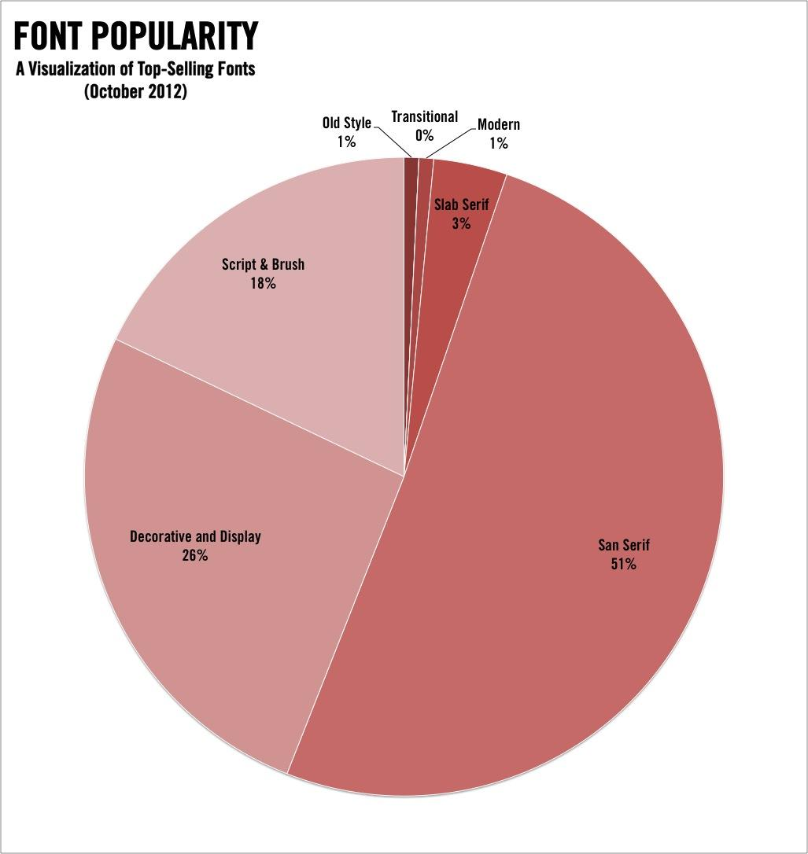
Type
Notes:
Jennifer

Slide 23
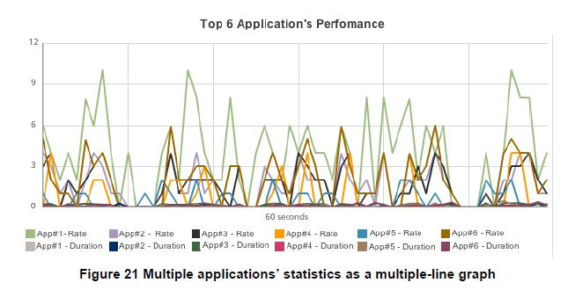
Space
Source
Notes:
Hannah - it is tempting to try to include all of the data at once. Most software will default to something that looks like this. Spaghetti.

Slide 24
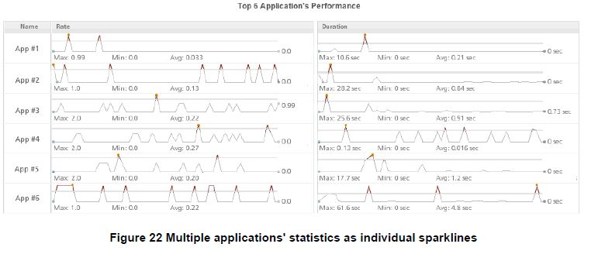
Space
Source
Notes:
Hannah - it is okay to re-design defaults to give the data (and your viewers) a little space.

Slide 25
Data Visualization
Examples
Notes:
All - Let’s discuss the following examples

Slide 26
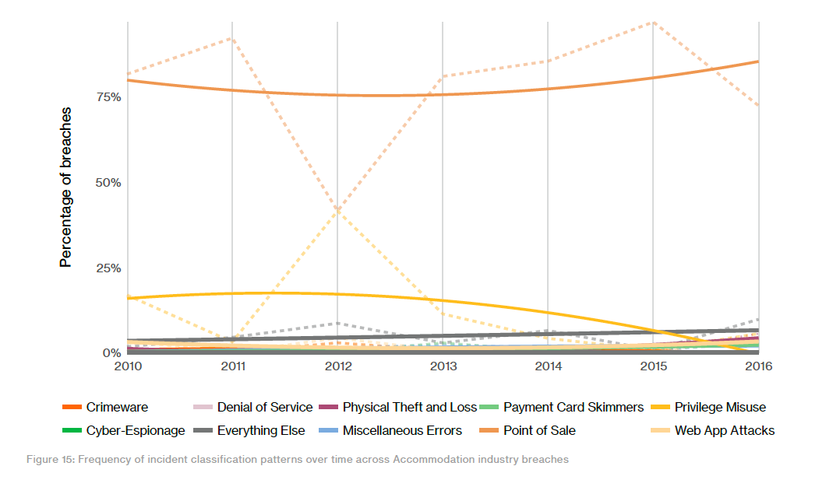
From the Verizon 2017 Data Breach Investigations Report 10th ed.

Slide 27
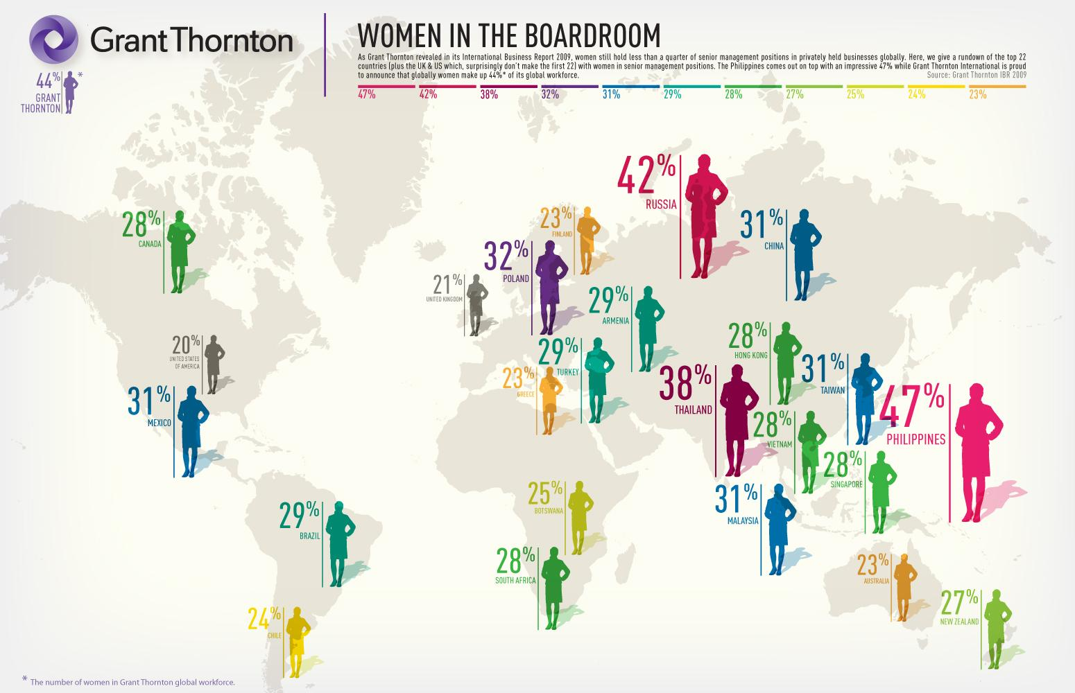

Slide 28
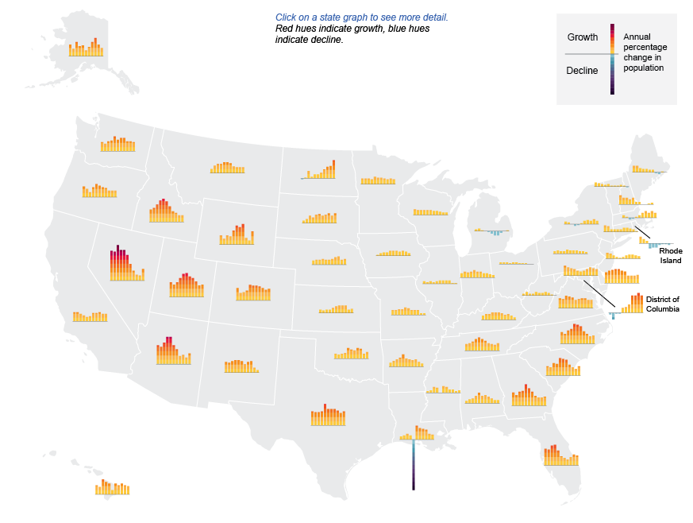
Source
Notes:
Click the link to interact

Slide 29
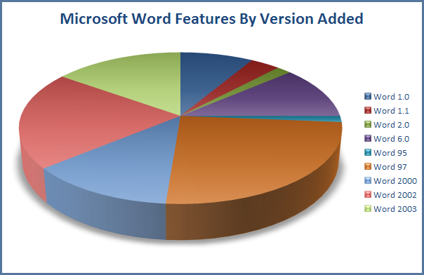
Source
Notes:
How would you redesign this?

Slide 30
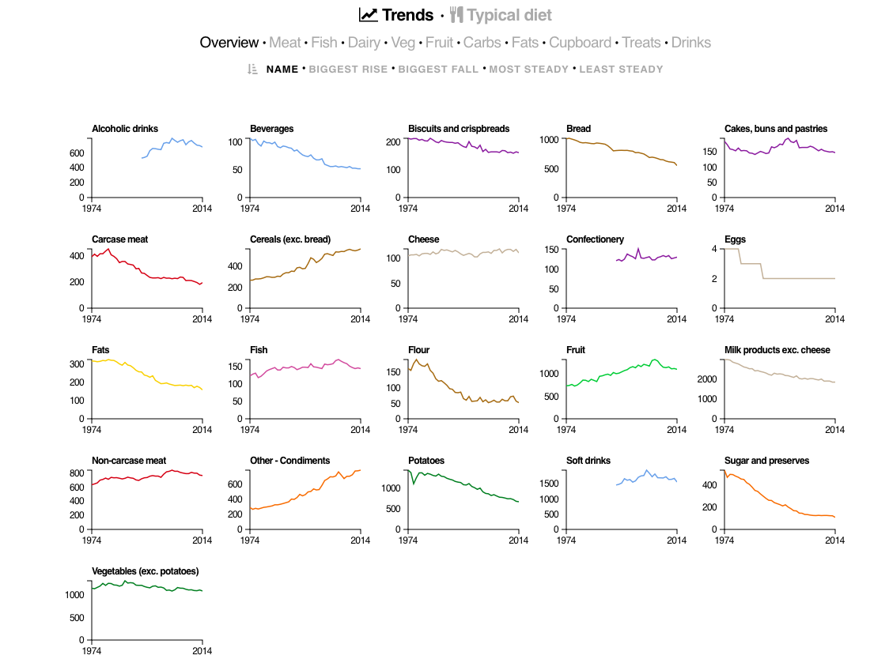
Source
Notes:
Jennifer - small multiples (show a 40 year period)

Slide 31
Data Visualization
Theory & Process

Slide 32
Grammar of Graphics
Originated by Leland Wilkinson, simplified by Hadley Wickham and others.
Data visualization is taking data and mapping it onto visual aesthetic, (points, lines, bars, etc).
Data
Geometry - visual encoding or symbol onto which the data is mapped. Each geom. has aesthetics (length, position, etc)
Grouping - subsets the data
Statistics - transforms or summarizes data
Mapping - maps the data onto the geometry
Source
Notes:
Alison

Slide 33
Data Visualization Process
getting data
getting to know the data
setting goals
determining if a visualization is needed
deciding what to visualize
cleaning
visualizing
designing
exporting/embedding for presentation
Notes:
Jennifer

Slide 34
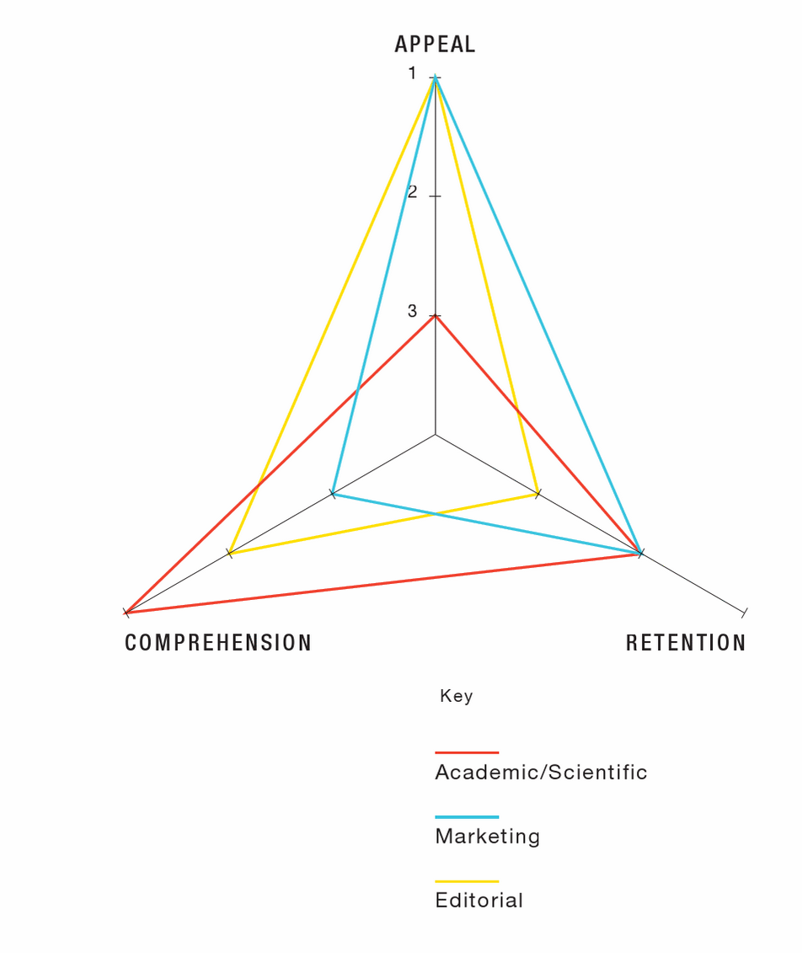
Important Considerations
Who is the audience?
What is the purpose or goal?
What is the story?
What are the domain standards or conventions?
from Infographics : The Power of Visual Storytelling by Lankow, Jason, Crooks, Ross, Ritchie, Josh
Notes:
Hannah - before and throughout the process, it is important to consider the audience, purpose/story, and any domain standards or conventions.

Slide 35
Data Visualization
Activity
Notes:
All

Slide 36
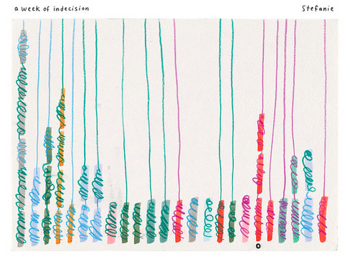
Exploring the Data Visualization Life Cycle
go.ncsu.edu/vizcrashcourse1
In this activity, we will explore the data visualization life cycle– data collection, data analysis, data visualization– and all of the considerations and decisions along the way.
Please refer to the handout.
This activity is inspired by the Dear Data Project.

Slide 37
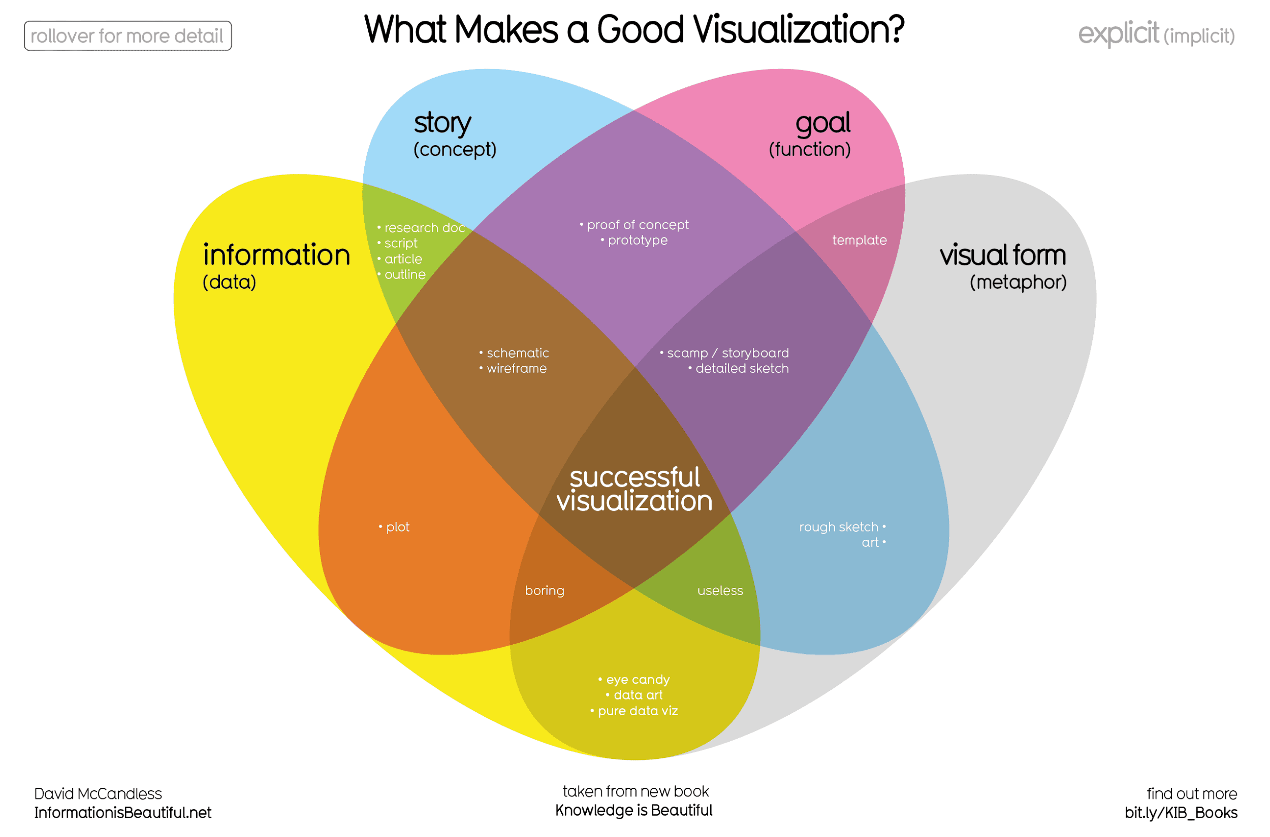

Slide 38
Reflection & Discussion
What were some issues or concerns you encountered during the activity?
Was anything surprising?
What considerations would you make when grading this assignment?
Notes:
Discuss these questions - outline a rubric as a group

Slide 39
Summary
This workshop incorporated best practices for teaching data visualization:
Lectures with examples
Large and small group discussion
Hands-on design activities
Group evaluation
Notes:
Hannah

Slide 40
Further Readings...
How to Spot Visualization Lies (Flowing Data)
Basic Rules for Making Charts and Graphs (Flowing Data)
Accepted Abstracts from Pedagogy of Data Visualization Workshop (IEEE 2016)

Slide 41
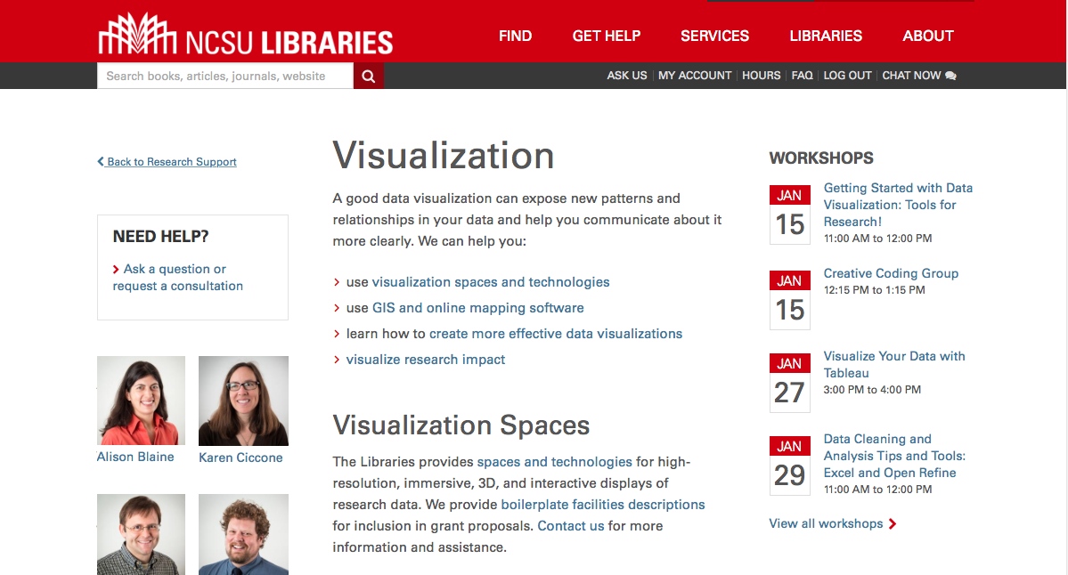
Ask Us
lib.ncsu.edu/do/visualization
ncsu-libraries.github.io/infographics/

